Slide 1

UNBROKEN TOKEN
Presented by :
Jason
Majid
Toni
Ragini
Dan
Steven

Slide 2

Scope and Purpose
Project Approach
Techniques used
Code Demonstrations
Challenges
Results (Demo)
Next Steps
TABLE OF CONTENTS

Slide 3
Similar to the UK Premium bonds but significantly riskier
Buy a token using ETH (works as a “ticket”)
Receive a token of UBT
ETH was gathered and staked in a central account
Staking profits are sent to central accounts
The central account’s earnings are distributed at random to % of UBT token holders each month
SCOPE & PURPOSE

Slide 4

PROJECT APPROACH
1. New token creation:
Solidity & remix
User inputs for initial supply, wallet and Crowd sale goal
Ganache used for sample accounts
2. ICO
Examined various launch tactics graduating price by time, rate, capping, refundable and post delivery
Explored polygon launch
Notes:
Update this from slack

Slide 5
TECHNIQUES USED
Python & Streamlit: For deploying the app
Dotenv: For accesing the .env file
Web3: For Web3 & HTTP Provider
Solidity, open zeppelin contracts and Remix : For crowd sale and Token

Slide 6
DEMONSTRATIONS
Notes:
Changes the image

Slide 7
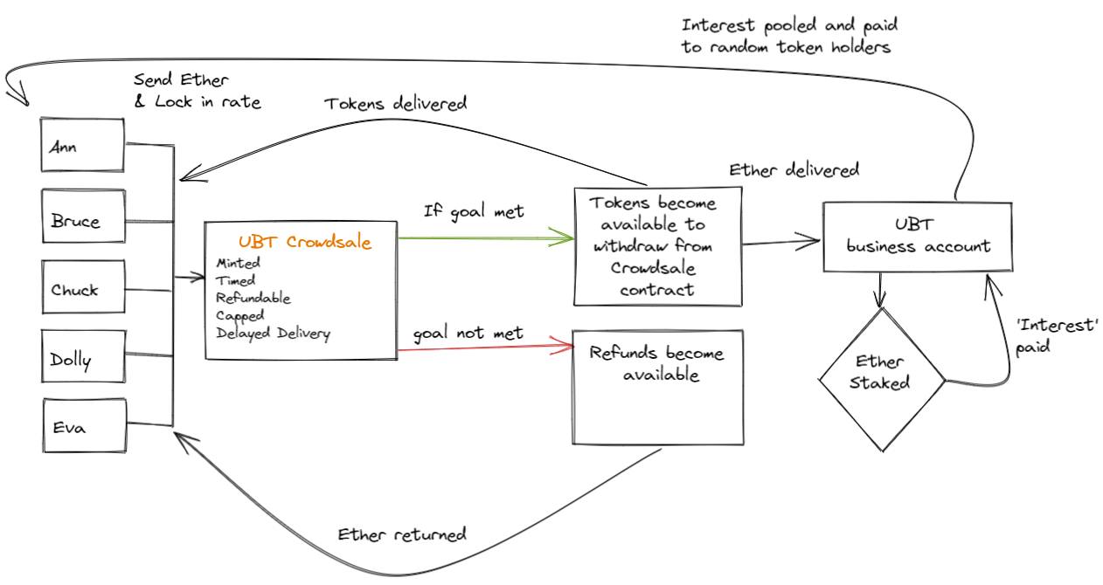
SUMMARIZED FLOWCHART

Slide 8
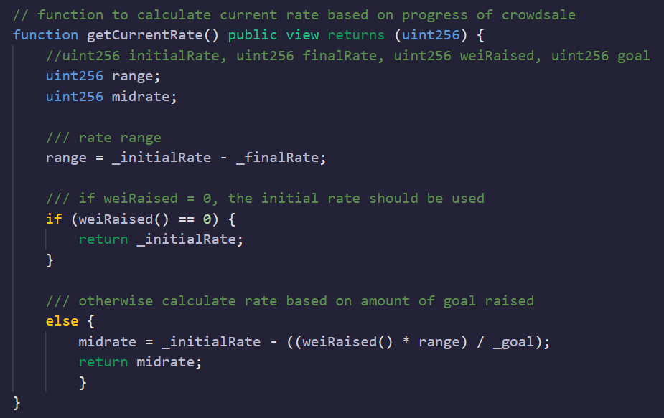
CROWDSALE RATE

Slide 9
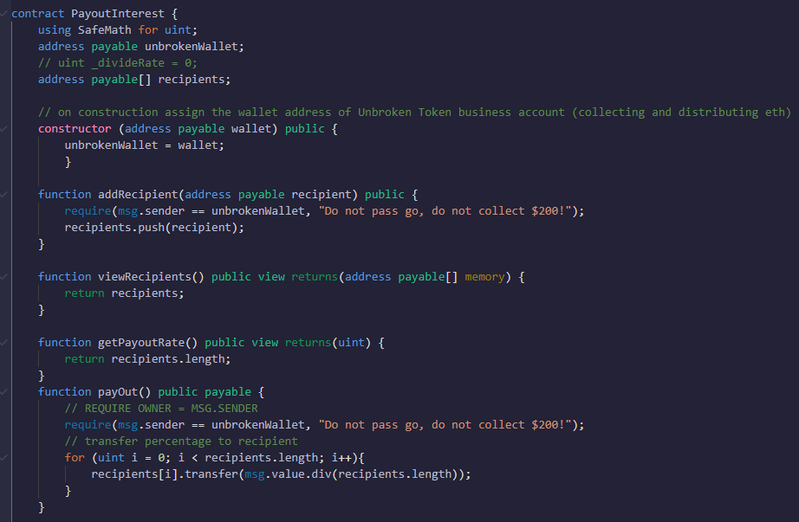
TRANSFER CONTRACT

Slide 10

Challenges
In Streamlit integrating multiple ABIs
Solidity language unable to support decimal places
Launching on polygon without test ETH
Handling time in solidity

Slide 11
RESULTS
Demonstration of code
Create token , functional Crowdsale, small contracts that handles interest distributions
Outputs from the code

Slide 12

NEXT STEPS
To automatically inflate the token based on some indexed rate for instance CPI, Bond yields
Payout the token inflation on a lottery system to current token holders
Run a node to stake the Ethereum without a third party
Build an API into the blockchain which will automatically find token holders’ distribution
Build the token holders' selection process into smart contracts for transparency

Slide 13


